Slide 1
Air Quality & Visibility in the Great Smoky Mountains
Vocational or Elective credit

Slide 2
The International Year of Sustainable Mountain Development
Year 2022 is…

Slide 3
How the Smoky Mountains got its name
Cherokee Native Americans called it “Shaconage,” which means “place of blue smoke.” (”The Great Smokies.Net, n.d.)
The “blue smoke” is fog or a natural haze due to the vegetation in the area releasing organic compounds/gases into the air that reacts with the humidity/water vapor in the air. (“The Place of Blue Smoke”, n.d.)

Slide 4
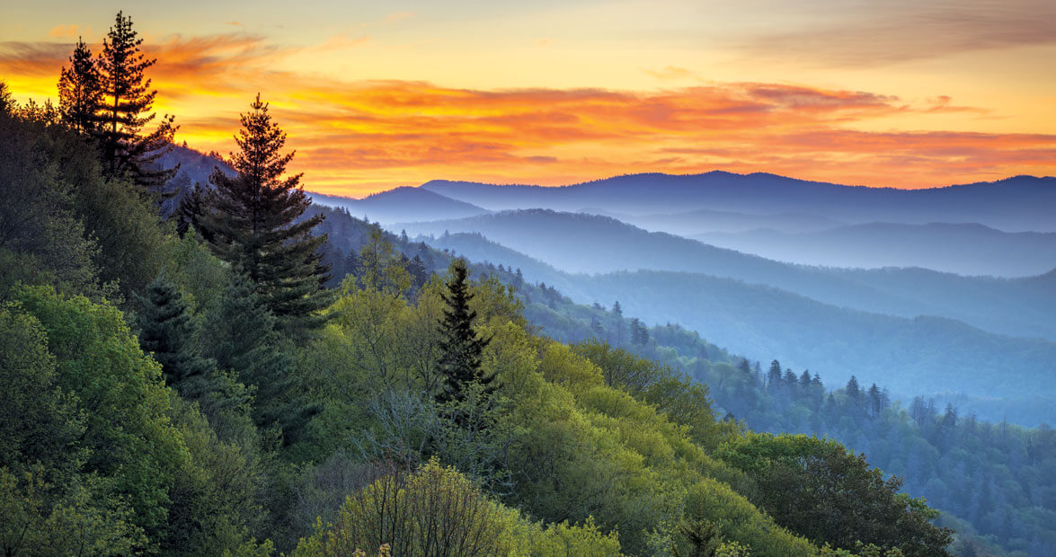
Blue Haze

Slide 5
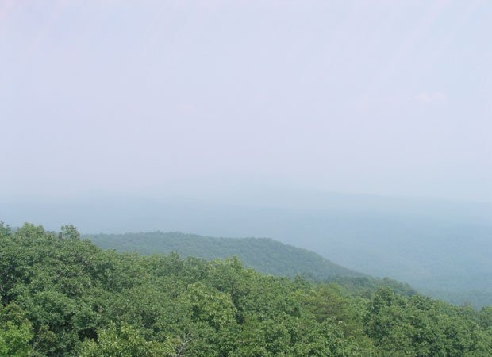
White Haze

Slide 6
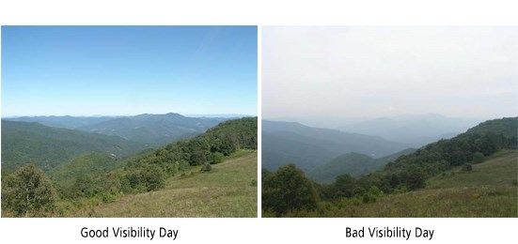

Slide 7
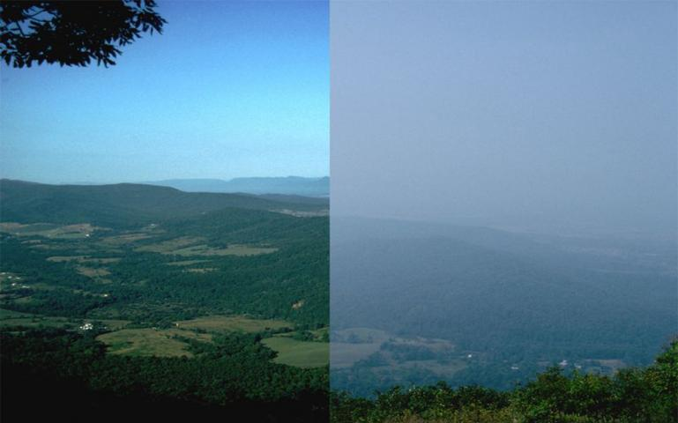

Slide 8
How is haze formed?
Known as “wet” air pollution due to the high-water content in atmosphere mixing with particles. (Corfidi, 1996)
Sulfate particles make up most of the chemistry of this haze. (Corfidi, 1996)
Haze is also caused by tiny particles that scatter and absorb light before it reaches an observer. (Gamnet: Realtime Air Pollution & Visibility Monitoring. (n.d.)
As the number of particles increases, more light is absorbed and scattered, resulting in less clarity, color, and visual range. (Gamnet: Realtime Air Pollution & Visibility Monitoring. (n.d.)

Slide 9
What particles help form haze?
Five types of particles contribute to haze:
Sulfate particles form in the air from sulfur dioxide gas.
Most of this gas is released from coal-burning power plants and other industrial sources, such as smelters, industrial boilers, and oil refineries.
Nitrate particles form in the air from nitrogen oxide gas.
This gas is released from virtually all combustion activities, especially those involving cars, trucks, off-road engines, power plants, and other industrial sources.
Organic particles are emitted directly into the air and form as a reaction of various gaseous hydrocarbons.
Sources of direct and indirect organic particles include vehicle exhaust, vehicle refueling, solvent evaporation (e.g., paints), food cooking, and various commercial and industrial sources.
Gaseous hydrocarbons are also emitted naturally from trees and from fires, but these sources have only a small effect on overall visibility.
Elemental carbon particles are very similar to soot.
They are smaller than most other particles and tend to absorb rather than scatter light.
These “brown clouds” are often seen in winter over urban areas and mountain valleys. These particles are emitted directly into the air from combustion activities, but are especially prevalent in diesel exhaust and smoke from the burning of wood and wastes.
Soil particles are very similar to dust.
They enter the air from dirt roads, fields, and other open spaces as a result of wind, traffic, and other surface activities.
(Gamnet: Realtime Air Pollution & Visibility Monitoring, n.d.)

Slide 10
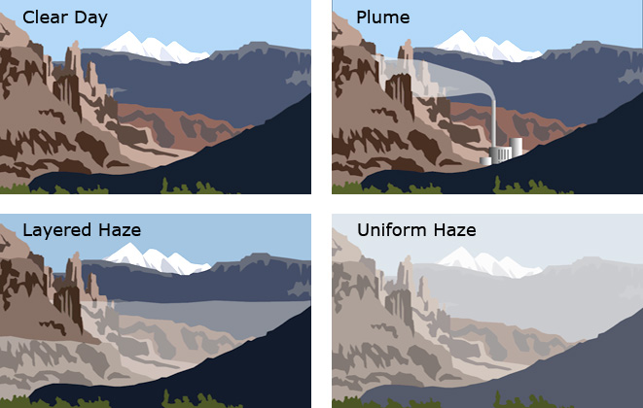

Slide 11
Coal plants
https://www.visualcapitalist.com/all-the-worlds-coal-power-plants-in-one-map/

Slide 12
C0₂ Health Concerns
These may include headaches, dizziness, restlessness, a tingling or pins or needles feeling, difficulty breathing, sweating, tiredness, increased heart rate, elevated blood pressure, coma, asphyxia, and convulsions.
The levels of CO2 in the air and potential health problems are:
400 ppm: average outdoor air level.
400–1,000 ppm: typical level found in occupied spaces with good air exchange.
1,000–2,000 ppm: level associated with complaints of drowsiness and poor air.
2,000–5,000 ppm: level associated with headaches, sleepiness, and stagnant, stale, stuffy air. Poor concentration, loss of attention, increased heart rate and slight nausea may also be present.
5,000 ppm: this indicates unusual air conditions where high levels of other gases could also be present. Toxicity or oxygen deprivation could occur. This is the permissible exposure limit for daily workplace exposures.
40,000 ppm: this level is immediately harmful due to oxygen deprivation.

Slide 13
Laws to help with Air Pollution & Visibility
Clean Air Act
Federal law that determines and regulates harmful air emissions and pollutants from stationary and mobile sources
Determined primary pollutants: particle pollution, ground-level-ozone, carbon monoxide, sulfur oxides, nitrogen oxides, and lead
Also established the National Ambient Air Quality Standards (NAAQS) to protect public heath
Helped to implement plans to reduce “regional haze” that impairs visibility in National Parks
1977 Amendment
“… established a national goal to prevent future and remedy existing visibility impairment in national parks larger than 6,000 acres and national wilderness areas larger than 5,000 acres that were in existence when the amendments were enacted, these are Class 1 Areas. All other areas are Class II. Air quality in both Class I and Class II areas is protected under the Clean Air Act and the Organic Act. Because air pollution is often regional in nature, reductions in pollution to meet national ambient air quality standards, improve visibility, and address other Clean Air Act requirements will also improve air quality in national parks.”
(“Protecting Air in Parks… It’s The Law”, n.d.)

Slide 14
Laws to help with Air Pollution & Visibility
Regional Haze Rule
“The Regional Haze Rule, published in 1999, requires states to identify the most effective means of preserving conditions in Class I areas when visibility is at its best (based on the 20% best or clearest visibility days monitored) and to gradually improve visibility when it is most impaired (based on the 20% worst visibility days monitored).”
Help jump start the Interagency Monitoring Protected Visual Environments (IMPROVE) program to measure the pollutants causing haze, which causes reduce visibility
Established the “Deciview” as the standard unit of measurement for haze
(“Protecting Air in Parks… It’s The Law”, n.d.)

Slide 15
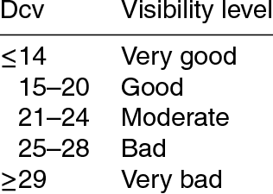
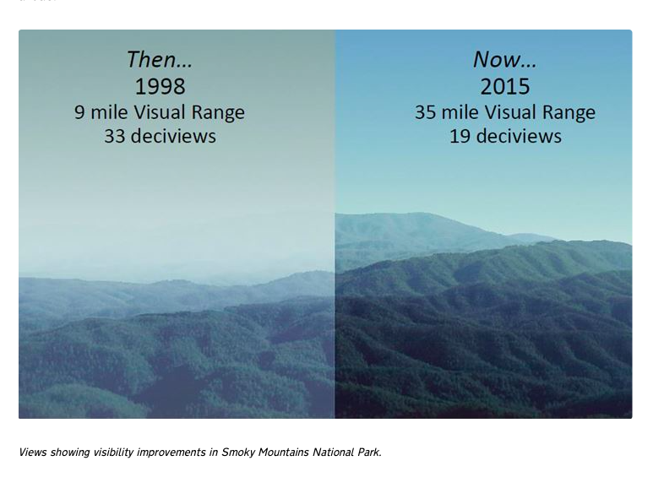
Deciview
(“Visibility Terminology”, n.d.)
The unit of measurement of haze, or "haze index".
Deciview is a measure of visibility derived from light extinction that is designed so that incremental changes in the haze index correspond to uniform incremental changes in visual perception, across the entire range of conditions from pristine to highly impaired.
HI = 10 ln (b_{ext}/10)
The haze index will be less than 0 for best values below 10.

Slide 16
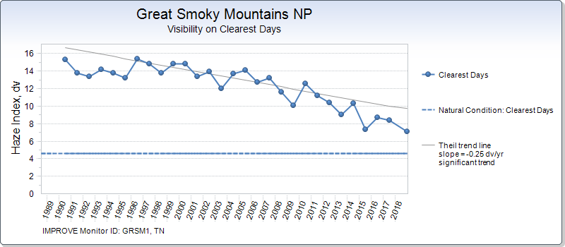
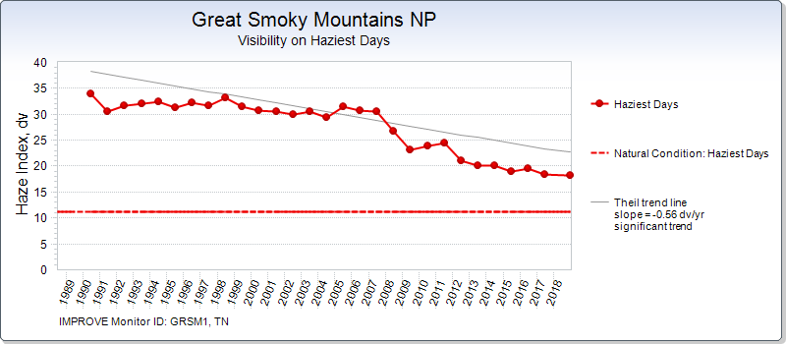
IMPROVE AQRV Summary Data

Slide 17
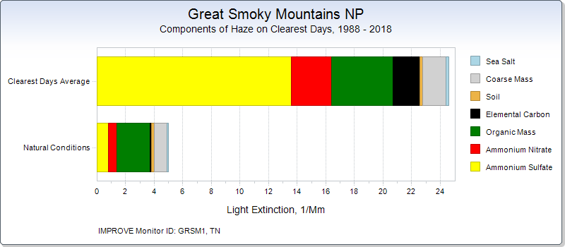
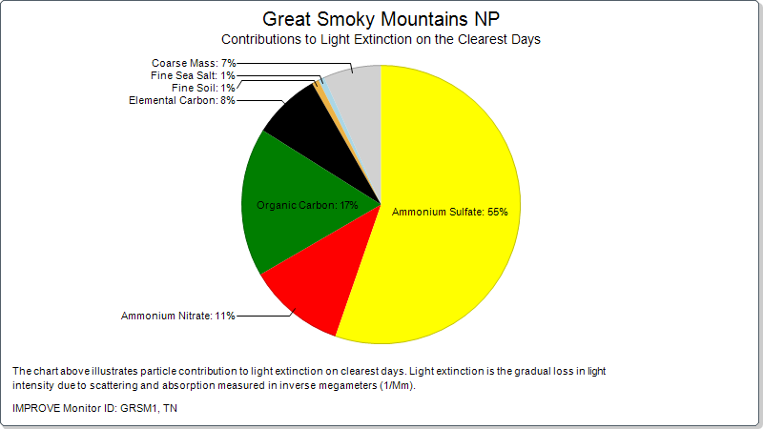
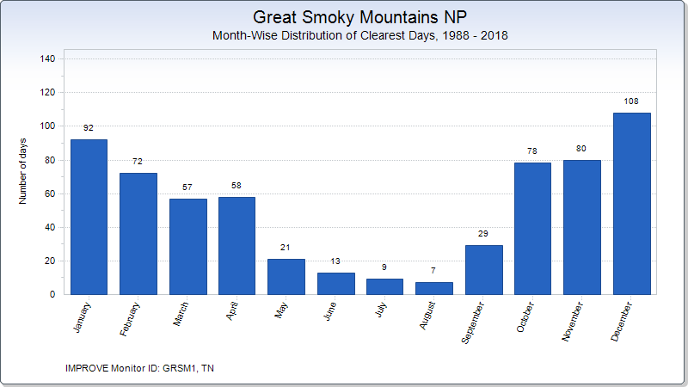
Clearest Days
IMPROVE AQRV Summary Data

Slide 18
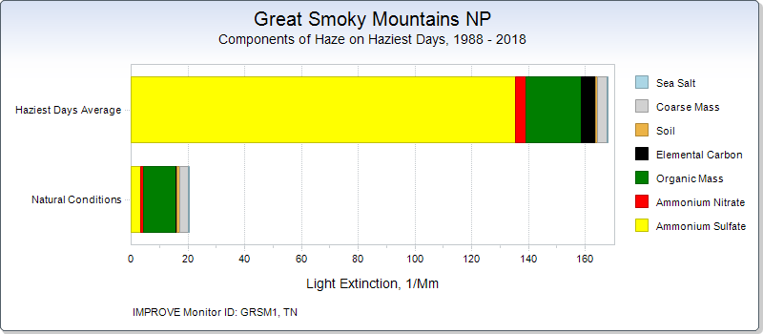
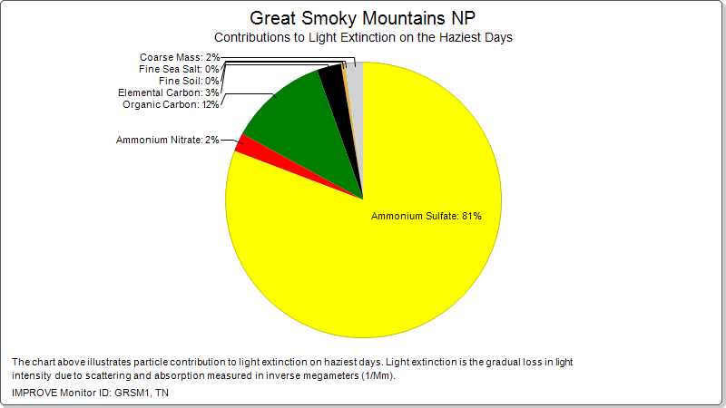
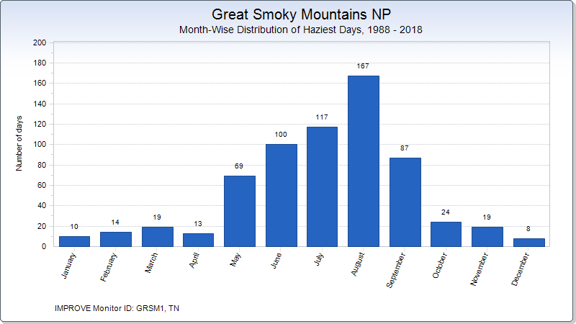
Haziest Days
IMPROVE AQRV Summary Data

Slide 19
How is visibility measured?
Air Quality Related Values (AQRVs) for Appalachian Highlands Network (APHN) Parks report states that:
“Various pollutants make up the haze that causes visibility degradation. IMPROVE measures these pollutants and reports them as ammonium sulfate, ammonium nitrate, elemental carbon, coarse mass, organic mass, sea salt, and soil…”
(Sullivan, 2016)

Slide 20
How is visibility measured?
Visibility data are collected at national parks by the NPS and other IMPROVE program participants
Air samplers draw in air and collect particles on small filters about the size of a quarter.
Park staff then collect these filters and mail them to a laboratory for analysis
https://www.nps.gov/subjects/air/howwemeasure-visibility.htm
(“How Do We Measure – Visibility” , n.d.)

Slide 21
Laws to help with Air Pollution & Visibility
Clean Air Act
Federal law that determines and regulates harmful air emissions and pollutants from stationary and mobile sources
Determined primary pollutants: particle pollution, ground-level-ozone, carbon monoxide, sulfur oxides, nitrogen oxides, and lead
Also established the National Ambient Air Quality Standards (NAAQS) to protect public heath
Helped to implement plans to reduce “regional haze” that impairs visibility in National Parks
1977 Amendment
“… established a national goal to prevent future and remedy existing visibility impairment in national parks larger than 6,000 acres and national wilderness areas larger than 5,000 acres that were in existence when the amendments were enacted, these are Class 1 Areas. All other areas are Class II. Air quality in both Class I and Class II areas is protected under the Clean Air Act and the Organic Act. Because air pollution is often regional in nature, reductions in pollution to meet national ambient air quality standards, improve visibility, and address other Clean Air Act requirements will also improve air quality in national parks.”
(“Protecting Air in Parks… It’s The Law”, n.d.)

Slide 22
Laws to help with Air Pollution & Visibility
Regional Haze Rule
“The Regional Haze Rule, published in 1999, requires states to identify the most effective means of preserving conditions in Class I areas when visibility is at its best (based on the 20% best or clearest visibility days monitored) and to gradually improve visibility when it is most impaired (based on the 20% worst visibility days monitored).”
Help jump start the Interagency Monitoring Protected Visual Environments (IMPROVE) program to measure the pollutants causing haze, which causes reduce visibility
Established the “Deciview” as the standard unit of measurement for haze
(“Protecting Air in Parks… It’s The Law”, n.d.)

Slide 23
References
Corfidi, S.F. (1996). Haze Over The Central And Eastern United States. National Weather Digest. Updated June 2013. Gamnet: Realtime Air Pollution & Visibility Monitoring. (n.d.). Retrieved from: https://origin.hazecam.net/poor-vis.aspx
King, P., & Stupka, A. (1950). The Great Smoky Mountains--Their Geology and Natural History. The Scientific Monthly, 71(1), 31-43.
NASA (n.d.). The Place of Blue Smoke. Retrieved from: https://earthobservatory.nasa.gov/images/89485/the-place-of-blue-smoke
National Park Association (n.d.). Great Smoky Mountains National Park. Retrieved from: https://www.nationalparks.org/explore-parks/great-smoky-mountains-national-park
Sullivan, T. (2016). Air quality related values (AQRVs) for Appalachian Highlands Network (APHN) parks: Effects from ozone; visibility reducing particles; and atmospheric deposition of acids, nutrients and toxics. Natural Resource Report NPS/APHN/NRR—2016/1152. National Park Service, Fort Collins, Colorado.
The Great Smokies.net (n.d.). About the Smokies. Retrieved from: http://www.thegreatsmokies.net/about-the-smokies/

Slide 24
References
U.S. Forest Service (n.d.). Visibility Terminology. Retreived from: https://www.fs.fed.us/air/visibilityTerminology.htm
U.S. National Park Service (n.d.). Visitation Numbers. Retrieved from: https://www.nps.gov/aboutus/visitation-numbers.htm
U.S. National Park Service (n.d.). How Do We Measure - Visibility. Retrieved from: https://www.nps.gov/subjects/air/howdowemeasure-visibility.htm
U.S. National Park Service (n.d.). Park Air Profiles – Great Smoky Mountains National Park. Retrieved from: https://www.nps.gov/articles/airprofiles-grsm.htm

Slide 25
Experiment
Video: https://www.youtube.com/watch?v=RoAjQA6KJSA

