Slide 1
Climate change around the world
Diversity, GSC, Elective

Slide 2
What is climate change?
Climate change is a change in the usual weather found in a place
Global warming refers to the long-term warming of the planet
Climate change includes warming and the “side effects” of warming—like melting glaciers, heavier rainstorms, or more frequent drought.

Slide 3
What causes climate change?
Natural
Changes in Earth’s orbit
Solar variations
Volcanic eruptions
Ocean currents

Slide 4
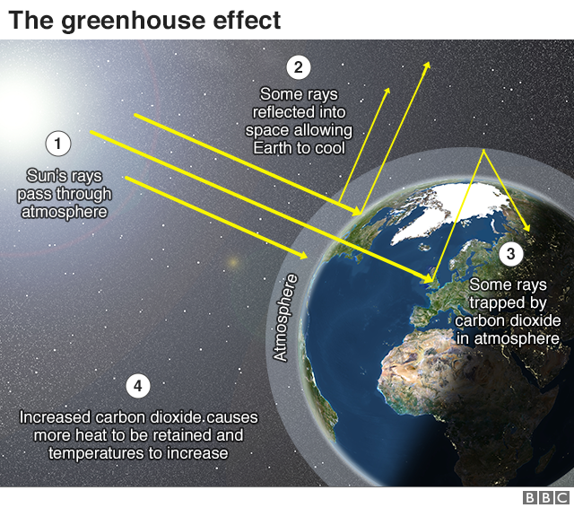
In the United States, most of the emissions of human-caused (anthropogenic) greenhouse gases (GHG) come primarily from burning fossil fuels—coal, natural gas, and petroleum—for energy use.

Slide 5
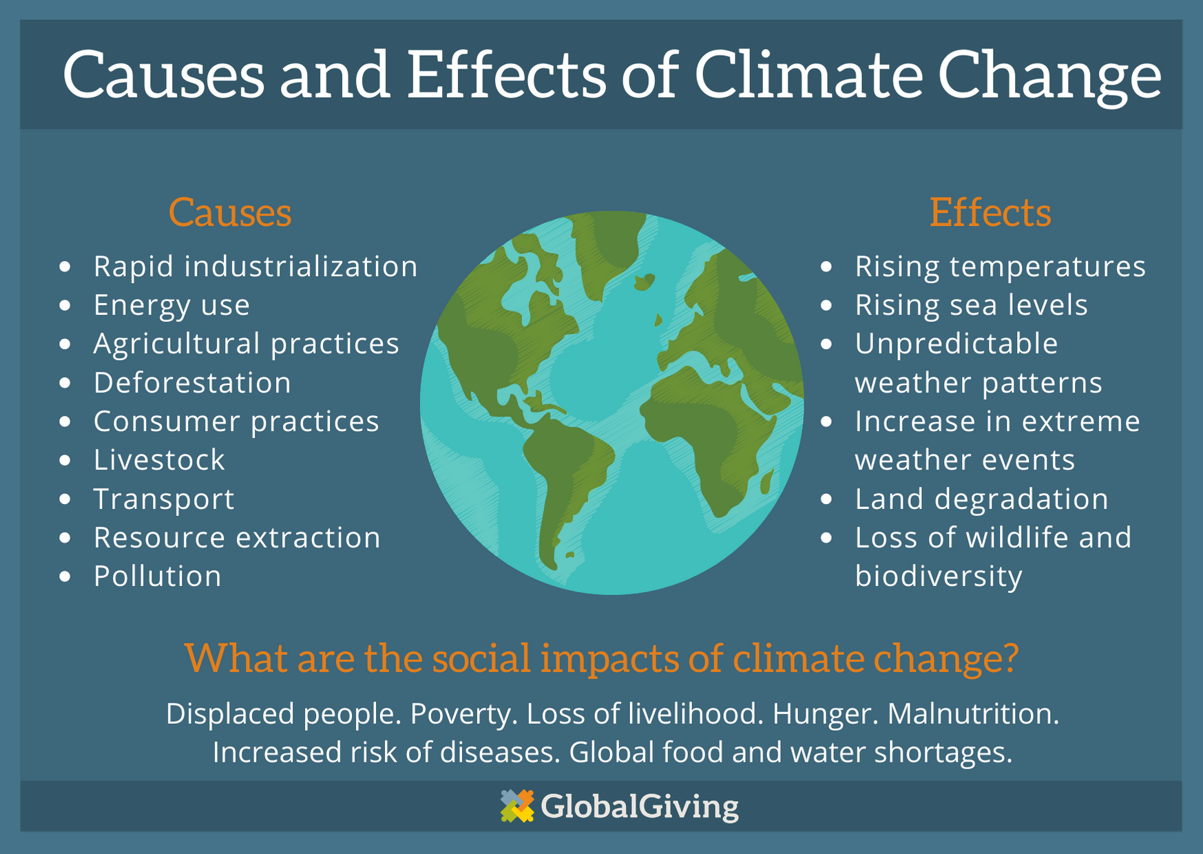

Slide 6
Interactive climate change sources

Slide 7
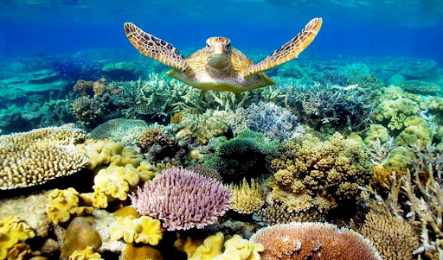
Great Barrier Reef
Australia
The largest coral reef system in the world
Rising ocean temperatures have caused coral bleaching - a condition in which the coral turns white and becomes prone to mass die-offs
As of 2020, an aerial survey by the Great Barrier Reef Foundation revealed the third mass bleaching in five years, with 60 percent of the reef's living corals dying as a result

Slide 8
Venice, Italy
Rising sea levels cause flooding in Piazza San Marco and other parts in the lower parts of the city
Activists have started investing in advanced flood gates and other technologies to prevent flooding

Slide 9
Glacier National Park
Montana, USA
As the glaciers melt, entire ecosystems will be altered, and scientists predict there will be little ice left after a couple more decades—and none at all by the end of the century
a warming climate has significantly reduced the size of 39 different glaciers in the park since 1966—the worst of which have seen reductions up to 85 percent

Slide 10
The Dead Sea
Large lake that borders Israel, Jordan, and the West Bank
The Dead Sea is shrinking at a rate of around three feet a year
Sinkholes are appearing in spots where the water has receded
The Middle East's increasingly hot climate makes it difficult for the lake to replenish itself
Construction of dams, storage reservoirs, and pipelines over the years has reduced inflow water levels to just five percent of their original volume

Slide 11
The Amazon
The largest rainforest on earth, the Amazon covers roughly 40 percent of South America
Extreme droughts have left tree species throughout the tropical jungle parched. As a result, they're vulnerable to large-scale dieback and more susceptible to forest fires
Brazil’s National Institute for Space Research identified more than 74,000 Amazon wildfires in 2019

Slide 12
Yamal Peninsula, Russia
Indigenous people are reindeer-herders
As the permafrost melts, the weather becomes increasingly unpredictable, and the vital winter season shortens
Climate scientists predict that this type of weather will only become more frequent as the earth continues to warm—a dangerous premonition for Russia's reindeer herds

Slide 13
The Maldives
Indian Ocean
Made up of a series of atolls—ring-shaped islands formed from coral—and with year-round temperatures that range from 81–84 degrees Fahrenheit
The lowest-lying country in the world (sitting an average of only 1.3 meters above sea level)
Risk of vanishing entirely

Slide 14
Mumbai, India
Home to almost 20 million people
Climate change could leave major parts of the city underwater in future decades if global temperatures continue to rise
According to the National Oceanic and Atmospheric Administration, global sea level is currently rising at a rate of roughly one-eighth of an inch per year

Slide 15
Key West
Florida, USA
The Army Corps of Engineers estimates that the sea level in the Florida Keys will rise 15 inches over the next 30 years

Slide 16
The Alps
This European mountain range (France, Italy, Germany, Austria, Slovenia, Switzerland, and Liechtenstein)
With increasing temperatures, however, significant snowmelt continues to shorten the season for winter sports
Scientists predict that by the end of the century, you'll have to climb up to the 10,000-foot mark to see snow on the mountains

Slide 17
Rio De janeiro, brazil
Projections show that if temperatures continue to increase, the sea level will rise up to 32 inches by the year 2100 - enough to cover the city's famous beaches, airport, and even some inland neighborhoods
Also lead to landslides, water shortages, and spreading of diseases

Slide 18
Osaka, japan
Sits at low elevation
Already susceptible to typhoons and heavy flooding, if global temperatures rises by 3 degrees Celsius as some scientists predict, major parts of the city will be buried by the ocean

Slide 19
Madagascar
Spans approximately 229,000 miles and just off the coast of Southeast Africa
Extended dry seasons have put fresh bamboo shoots in short supply, which feed Madagascar’s population of lemurs
More frequent flooding and rising sea levels are destroying habitats in the forests
Coral bleaching in coastal reefs threatens the survival of many marine species

Slide 20
Lagos, nigeria
The most populous city in Nigeria - 20 million residents
Lagos is a commercial and cultural hub situated on the Gulf of Guinea
Home to dozens of gorgeous white-sand beaches
The increased frequency of heavy rainstorms are putting serious strain on the city’s infrastructure, and rising sea levels only serve to exacerbate the issue

Slide 21
Canada
People were displaced because of flooding, which afflicted the southern region of British Columbia
Heavy snow packs were melted by record high temperatures in April, causing rivers to overflow
Suffered the worst wildfire season on record resulting in the evacuation of 16,000 people, as 2,117 wildfires burned through the region and caused smoke-filled skies in west Canada, making the air quality among the worst in the world

Slide 22
How climate change affects people living in poverty

Slide 23
How climate change affects people living in poverty
Their struggle to earn a living, feed their families and create stable homes is made more difficult every day the climate crisis continues
Climate change threatens the cleanliness of the air, depletes the water sources and limits food supply
The increased frequency and intensity of extreme weather events like hurricanes, wildfires and droughts threaten lives in these front-line communities, driving people from their homes and jeopardizing food sources and livelihoods.
All these effects increase the likelihood of more conflict, hunger and poverty

Slide 24
Paris Agreement
In December 2015, 194 countries and the European Union signed up to the Paris Agreement.
This is the most important pact for international cooperation to tackle climate change
By signing the Agreement, the world’s nations have committed to limit the increase in global warming to 'well below 2°C', with a goal to keep it to 1.5°C

Slide 25
How can we reduce climate change?
Talk to local governments to implement
Eat less meat and dairy
Cut back on flying
Reduce energy use
Look into sustainable energy sources
Respect and protect green spaces
Cut down on consumption and waste
Recycle

